Slide 1
Urban Garden Project

Slide 2
What is a “Food Desert”?
While watching the video, focus on answering the following two questions:
What is a food desert?
What effects do food deserts have on the people who live in it?
Record your answers to the questions on your paper.

Slide 3
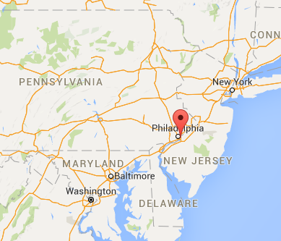
Where are food deserts?
The food desert shown in the video is in New Jersey.
Think of places you know in Texas. Are there food deserts there?
Let’s check!

Slide 4
Where are food deserts?
The food desert shown in the video is in New Jersey.
Think of places you know in Texas. Are there food deserts there?
Let’s check!

Slide 5
Group Brainstorm
With your group, brainstorm alternatives to grocery stores members of food deserts can (or have) use to access healthy produce (fruits and vegetables).
Write your answers on the back of your handout. Be prepared to share your answers with the class.

Slide 6
Summer Design Challenge
Project Overview and Expectations

