Slide 1
Friday, 10.9 and Monday, 10.13
Please pick up your RAW book as you enter.

Slide 2
TODAY’S AGENDA
Introduction to Omnivore’s Dilemma
Annotation Notes/Reading Assignments
Focus on Chs. 1-4 – key ideas and take-aways
Begin reading Ch. 5/Annotating for Main Idea
LOOKING FORWARD
Chapters 5-6/Annotations for Main Idea and details due
Wednesday, 10.16/Monday, 10.19

Slide 3
Annotation Guide
On the inside cover of your book, record this information:
Main Idea (Controlling Idea) & Supporting Details
Rhetorical Devices
Organizational Patterns
Theme
Purpose
You will annotate for each of these ideas at some point during our study of the text.
Tips for annotating:
Write a marginal note for every highlighted mark; notes can be questions, labels, explain ideas, summarize a moment, etc.
Use a ? to mark information you don’t understand
Use brackets [ ] to mark consecutive sentences that are valuable, and then highlight key phrases within the area.
Use asterisks *** to indicate something unusual, special, or particularly important.

Slide 4
Reading Due Dates
Reading Assignment… | Annotate for…
Chapters 5&6 due Fri., 10.16/Mon., 10.19 | Main Idea & Details
Chapters 7,8, & 9 due Mon., 10.26/Tues., 10.27 | Rhetorical Strategies

Slide 5
Do Now: Food Choices and Costs
“While it is true that many people simply can't afford to pay more for food, either in money or time or both, many more of us can. After all, just in the last decade or two we've somehow found the time in the day to spend several hours on the internet and the money in the budget not only to pay for broadband service, but to cover a second phone bill and a new monthly bill for television, formerly free. For the majority of Americans, spending more for better food is less a matter of ability than priority.” (187) ― Michael Pollan, In Defense of Food: An Eater's Manifesto
Reflect on the quote above. Now consider:
Why do people eat what they do?
What factors do we consider when we make a food choice?
What is “cost”?

Slide 6
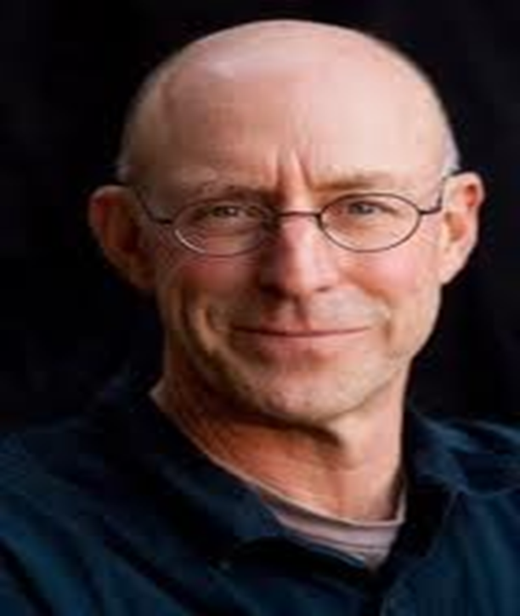
Meet Michael Pollan
Michael Pollan was born in 1955 on Long Island.
He was educated at Bennington College, Oxford University, and Columbia University, from which he received a Master’s in English.
He has authored several books, including:
Second Nature: A Gardener’s Education,
In Defense of Food: An eater’s Manifesto,
Cooked: A Natural History of Transformation,
The Botany of Desire: A Plant's-Eye View of the World
He lives in the Bay Area with his wife, the painter Judith Belzer, and their son, Isaac.

Slide 7
On to the main dish– Omnivore’s Dilemma
Overview of Omnivore's Dilemma
Michael Pollan writes in the Introduction that “because we are omnivores we have very little built-in instincts that tell us which foods are good for us and which aren’t. That’s the dilemma – we can eat anything, but how do we know what to eat?” (3-4)

Slide 8
FOUR MEALS – A food chain is a system for growing, making, and delivering food. ** We will study three of the four food chains.
INDUSTRIAL **
This chain starts in a giant field, usually in the Midwest, where a single crop is grown – corn, or perhaps soybeans – and ends up in a supermarket or fast-food restaurant. This is where most of our food comes from.
INDUSTRIAL ORGANIC **
This food is grown on large industrial farms, but with only natural fertilizers, and natural bug and weed control. It is sold in the same way as industrial food.
LOCAL SUSTAINABLE **
This is food grown on small farms that raise lots of different kinds of crops and animals. The food from the farm doesn’t need to be processed, and it travels a short distance – to a farmer’s market, for example – before it reaches your table.
HUNTER-GATHERER
This is the oldest type of food chain there is. It’s hardly a chain at all, really. It is made up simply of you, hunting, growing, or finding your food.

Slide 9
As we begin reading, think about this statement . . .
“The feeling of being connected to food . . . [is] an experience that . . . most of us are missing today. We’re so confused about food that we’ve forgotten what food really is – the bounty of the earth and the power of the sun captured by plants and animals.” (6)
Michael Pollan, Introduction to Omnivore’s Dilemma

